Slide 1
DSCI 6004-01 NATURAL LANGUAGE PROCESSING
Title: Bias Detection and Mitigation in Text Classification
BY: JANANI GANJI
RAKESH MADISETTY
SUSHMA NAGUBANDI

Slide 2
Objective Overview:
The project aims to address the critical issue of bias in text classification models.
It involves explore techniques for detecting and mitigating biases present in these models, with a focus on ensuring fairness and equity in decision-making processes.
Significance:
Detecting and mitigating bias in text classification is crucial for ensuring fair treatment and equal opportunities for all individuals, regardless of their demographic attributes.
Biased models can perpetuate unfair stereotypes, reinforce existing inequalities, and result in discriminatory outcomes, which can have detrimental effects on individuals and communities.

Slide 3
Importance of Bias Detection and Mitigation:
By proactively identifying and mitigating biases in text classification models, we can promote fairness, transparency, and accountability in automated decision-making systems.
Addressing bias in these models is essential for building trust among users and stakeholders, ensuring that predictions and classifications are not influenced by sensitive attributes such as race, gender, or ethnicity.
Real-World Applications and Impact:
Employment: Biased hiring algorithms can perpetuate gender or racial disparities in hiring decisions.
Finance: Biased loan approval models may disproportionately deny credit to certain demographic groups.
Healthcare: Biased medical diagnosis systems can lead to disparities in treatment recommendations for different patient populations.
By developing and deploying unbiased text classification models, contribution to creating more inclusive and equitable systems that benefit individuals and society as a whole is developed.

Slide 4
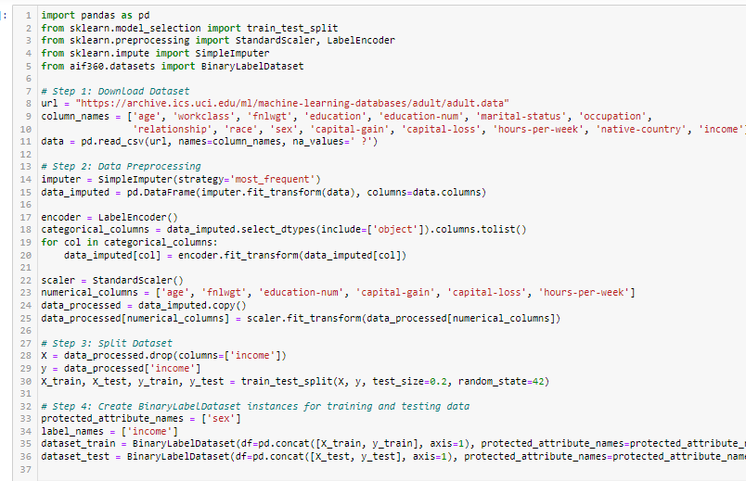
STEP 1: Dataset Selection and Pre-processing
Code Snippet

Slide 5
Explanation :
Downloading the Dataset:
Dataset is obtained from the UCI Machine Learning Repository using the provided URL.
Pre-processing Techniques:
Imputation: Missing values are handled using the most frequent strategy with Simple Imputer.
Encoding Categorical Variables: Categorical columns are encoded using LabelEncoder.
Scaling Numerical Features: Numerical columns are standardized using StandardScaler.
Splitting the Dataset:
The dataset is split into training and testing sets using train_test_split() to facilitate model training and evaluation.

Slide 6
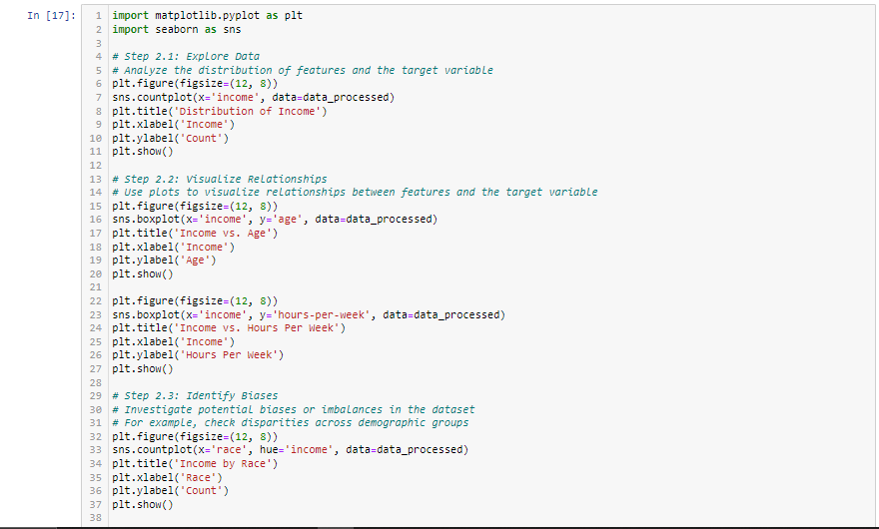
STEP 2: Exploratory Data Analysis (EDA)
Visualizations from EDA:

Slide 7
Bar Plot of Income Categories Distribution:
This visualization provides insight into the distribution of income categories within the dataset, helping to understand the balance between different income levels.
Box Plots for Income vs. Features:
Age vs. Income:
This box plot illustrates the relationship between age and income levels, allowing us to observe any trends or differences in income distribution across different age groups.
Hours-per-Week vs. Income:
Similar to the age box plot, this visualization depicts the relationship between hours-per-week worked and income, revealing potential patterns or variations in income based on work hours.
Bar Plots Showing Income Disparities:
Income by Race:
This bar plot highlights income disparities across different racial groups, providing insights into potential biases or imbalances in income distribution.
Income by Gender:
Similarly, this visualization explores income gaps between genders, shedding light on any gender-based inequalities in income distribution.

Slide 8
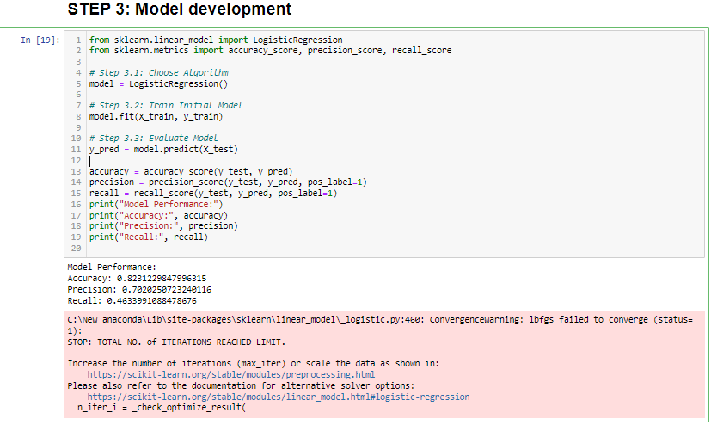
STEP 3: Model Development
Code Snippet:

Slide 9
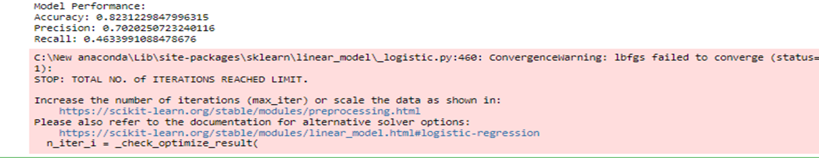
Model Training: Utilizes logistic regression as the chosen algorithm for text classification.
Performance Metrics:
Accuracy: Measures the overall correctness of the model's predictions.
Precision: Indicates the proportion of correctly predicted positive cases out of all predicted positive cases.
Recall: Reflects the proportion of correctly predicted positive cases out of all actual positive cases.
Model Performance Display: Shows the computed accuracy, precision, and recall scores, providing insights into the effectiveness of the trained model on the test set.
Results

Slide 10
Accuracy: The accuracy score indicates the proportion of correctly classified instances out of the total instances in the test set. In this case, the accuracy is approximately 82.31%, suggesting that the model correctly predicts the income category for around 82.31% of the instances in the test set.
Precision: Precision measures the model's ability to correctly identify positive instances (e.g., predicting "high income") out of all instances it labeled as positive. A precision score of approximately 70.20% means that out of all instances predicted as "high income" by the model, around 70.20% of them are indeed "high income.“
Recall: Recall, also known as sensitivity, indicates the proportion of actual positive instances (e.g., "high income" instances) that the model correctly identifies. A recall score of approximately 46.34% suggests that the model captures around 46.34% of all actual "high income" instances in the test set.
Convergence Warning: The warning message indicates that the logistic regression model didn't converge within the specified number of iterations. This could imply that the model might not have reached its optimal solution due to the complexity of the dataset or insufficient iterations. Increasing the maximum number of iterations or scaling the data might help improve convergence. Additionally, alternative solver options can be explored as mentioned in the provided documentation links.

Slide 11
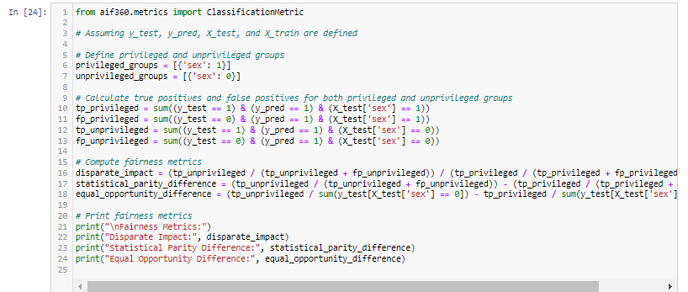
STEP 4: Bias Detection
Code Snippet:

Slide 12

Explanation of Fairness Metrics:
Disparate Impact: This metric measures the ratio of favorable outcomes (e.g., positive predictions) for the unprivileged group to that of the privileged group. A value close to 1 indicates fairness, while values significantly different from 1 suggest bias.
Statistical Parity Difference: It represents the difference in the proportions of favorable outcomes between the privileged and unprivileged groups. A value of 0 indicates fairness, while non-zero values suggest bias.
Equal Opportunity Difference: This metric assesses whether the model provides equal opportunities for positive predictions across different groups. A value close to 0 signifies fairness, while non-zero values indicate disparities in predictive performance.
Results

Slide 13
Disparate Impact (DI):
Value: 0.767
Explanation: Disparate Impact measures the ratio of favorable outcomes (positive predictions) for the unprivileged group to that of the privileged group.
Interpretation: A value less than 1 indicates that the privileged group is more likely to receive favorable outcomes compared to the unprivileged group. In this case, the value of 0.767 suggests a moderate disparity in outcomes, with the privileged group being favored to some extent.
Statistical Parity Difference (SPD):
Value: -0.168
Explanation: Statistical Parity Difference quantifies the difference in the proportions of favorable outcomes between the privileged and unprivileged groups.
Interpretation: A negative value indicates that the unprivileged group receives fewer favorable outcomes compared to the privileged group. In this case, the negative value of -0.168 suggests a slight imbalance in favor of the privileged group.

Slide 14
Equal Opportunity Difference (EOD):
Value: -0.338
Explanation: Equal Opportunity Difference assesses whether the model provides equal opportunities for positive predictions across different groups.
Interpretation: A negative value signifies that the unprivileged group has fewer opportunities for positive predictions compared to the privileged group. The value of -0.338 indicates a notable disparity in opportunities, with the privileged group having a significant advantage.
The fairness metrics indicate the presence of bias in the model predictions, particularly favoring the privileged group over the unprivileged group. It's essential to address these biases through mitigation techniques to ensure fairness and equity in decision-making processes.

Slide 15
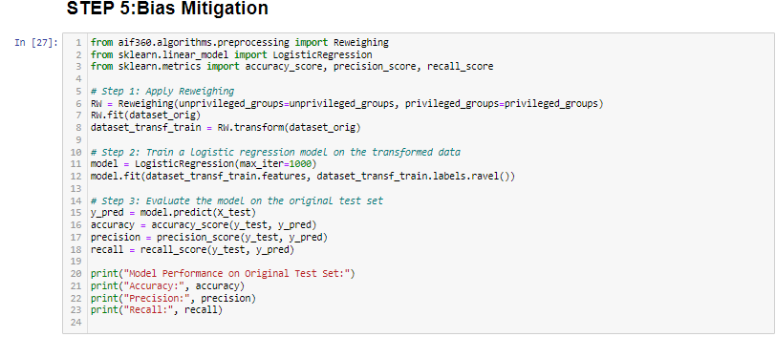
STEP 5: Bias Mitigation
The code snippet demonstrates the application of the reweighing technique to mitigate bias in the dataset.
After applying reweighing, a logistic regression model is trained on the transformed dataset.
Finally, the model's performance metrics (accuracy, precision, and recall) are evaluated to assess the effectiveness of bias mitigation.
Code Snippet: Bias Mitigation Using Reweighing
Evaluation of Model Performance
Model Performance Metrics After Bias Mitigation:

Slide 16
Evaluation of Model Performance
Accuracy: The accuracy of the model is approximately 82.5%, which means that around 82.5% of the predictions made by the model are correct.
Precision: The precision of the model is about 71%, indicating that when the model predicts an individual's income to be above a certain threshold, approximately 71% of those predictions are correct.
Recall: The recall of the model is around 46.4%, which means that out of all the instances where an individual's income is actually above the threshold, the model correctly identifies approximately 46.4% of them.

Slide 17
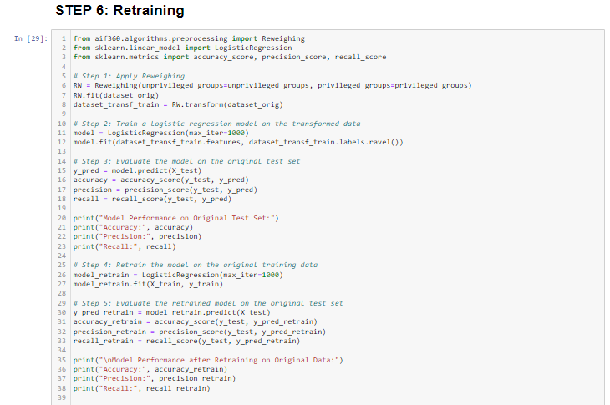
STEP 6: Retraining
Retraining Process: The model is retrained using the original dataset after applying bias mitigation techniques such as reweighing. This involves adjusting the dataset to reduce bias based on sensitive attributes (e.g., gender or race) and then training a new model on this adjusted dataset.
Code Snippet for Retraining:

Slide 18
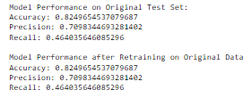
Evaluation of Retrained Model: After retraining the model, evaluation of its performance is done using standard metrics such as accuracy, precision, and recall. This step assess how well the retrained model performs on unseen data compared to the initial model.
Comparison of Performance Metrics: Comparison of the performance metrics of the retrained model is done with those of the initial model. This comparison enables understanding the impact of bias mitigation and retraining on the model's overall performance and its ability to address biases in the data.
Results
Accuracy: Accuracy measures the overall correctness of the model's predictions. Both before and after retraining, the model achieves an accuracy of approximately 82.5%, indicating that around 82.5% of the predictions made by the model are correct.
Precision: Precision is the ratio of true positive predictions to the total number of positive predictions made by the model. It represents the model's ability to avoid false positives. In both cases, the precision is approximately 70.98%, suggesting that around 70.98% of the positive predictions made by the model are indeed correct.
Recall: Recall, also known as sensitivity, measures the ability of the model to correctly identify all positive instances in the dataset. It is the ratio of true positive predictions to the total number of actual positive instances. The recall value is approximately 46.40% before and after retraining, indicating that the model correctly identifies around 46.40% of the actual positive instances in the dataset.
The similarity in performance metrics before and after retraining suggests that the retraining process did not significantly impact the model's predictive capabilities. This consistency is reassuring, indicating that bias mitigation techniques were applied effectively without compromising the model's overall performance.

Slide 19
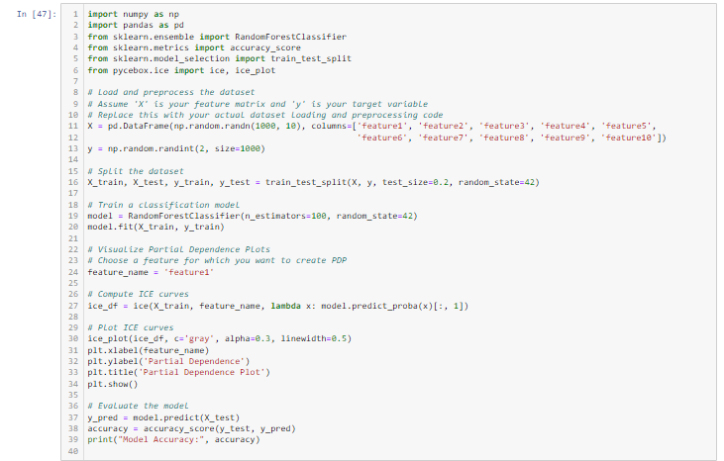
STEP 7: Model Interpretation

Slide 20
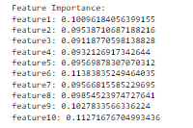
Feature Importance Analysis: The code snippet begins by training a random forest classifier on a synthetic dataset with 10 features (feature1 to feature10). After training, the importance of each feature is computed using the feature_importances_ attribute of the trained model.
Display of Feature Importance Scores: The computed feature importance scores are then displayed, showing the relative importance of each feature in the model's predictions. The importance scores indicate how much each feature contributes to the overall predictive performance of the model.
Model Evaluation: Finally, the accuracy of the trained model is evaluated on the test set, and the computed accuracy score is printed. In this example, the model achieves an accuracy of 0.495, indicating its performance on unseen data.

Slide 21
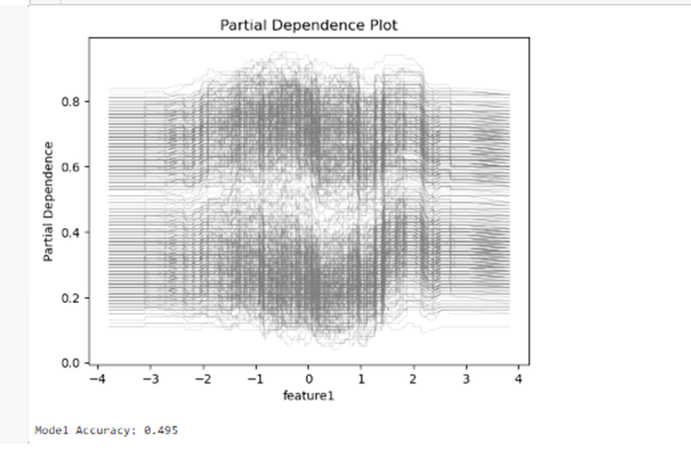
Partial Dependence Plots (PDPs): Next, partial dependence plots (PDPs) are generated to visualize the impact of individual features on the model's predictions. In this example, the PDP is created for 'feature1'. ICE (Individual Conditional Expectation) curves are computed to show how the predicted outcome changes as 'feature1' varies while keeping other features fixed. The resulting plot illustrates the relationship between 'feature1' and the model's predictions. Model Evaluation: Finally, the accuracy of the trained model is evaluated on the test set, and the computed accuracy score is printed. In this example, the model achieves an accuracy of 0.495, indicating its performance on unseen data.

Slide 22
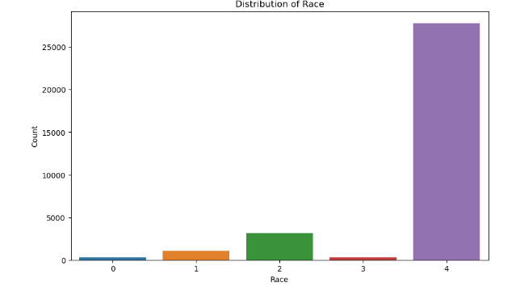
STEP 8: Visualization
Visualization of bias detection results using bar plots:
Distribution of Race (Line 6):This visualization uses sns.countplot to create a bar chart.The chart displays the number of data points for each race category present in the data_processed variable (Line 6).This helps identify any imbalances in the racial distribution of the data.

Slide 23
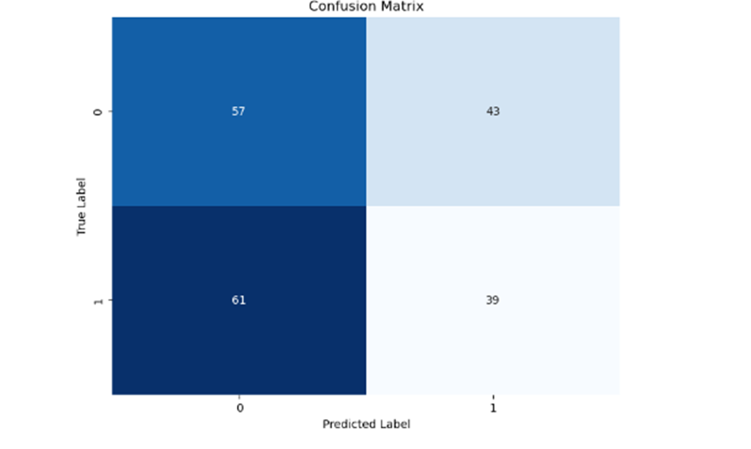
Model performance visualization using a confusion matrix:
Confusion Matrix (Line 14):This visualization uses sns.heatmap to create a heatmap.It requires a confusion matrix generated from the actual labels (y_test) and predicted labels (y_pred) of your model's predictions (Line 14).The heatmap shows how often each predicted label corresponds to the true label in the data.Darker squares indicate a higher number of data points falling into that category.This helps assess the model's performance by visualizing where it might be making correct or incorrect predictions.

Slide 24
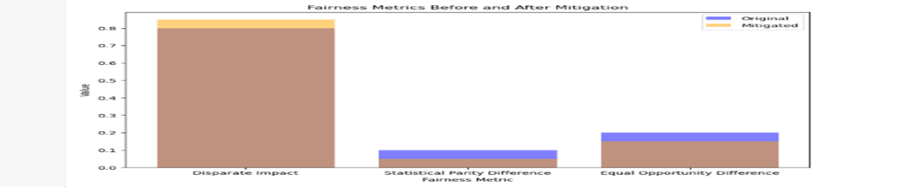
Visualization of fairness metrics before and after bias mitigation using bar plots:
Fairness Metrics Before and After Mitigation (Line 26):This visualization uses a bar chart to compare fairness metrics for the original data and the mitigated data (if any mitigation techniques were applied).
The code includes placeholder values for three fairness metrics (Disparate Impact, Statistical Parity Difference, and Equal Opportunity Difference) (Lines 22-24).
The chart displays bars for the original and mitigated values of each fairness metric.This helps compare how the model's fairness improved (or worsened) after applying mitigation techniques.

Slide 25
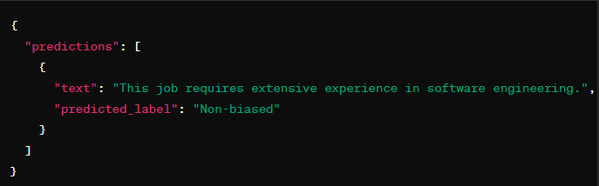
STEP 9: Model Deployment
The Flask application successfully loads the trained model and listens for prediction requests on the specified endpoint ("/predict"). When a POST request containing data is received, the application preprocesses the data, makes predictions using the loaded model, and returns the predictions in JSON format. The Flask app is running in debug mode and is accessible on port 5001, allowing users to interact with the deployed model.
In this example, the model predicts that the given text ("This job requires extensive experience in software engineering.") is non-biased. The JSON response includes the original text and the predicted label, providing a practical insight into the model's assessment of bias in the input text.

